Slide 1

Allegheny County Treasury
Tax Delinquency Analysis
Tyler Kellar, Behnam Fallah, John Morris, Jacob Hunsinger
April 16th, 2025

Slide 2
Part I: Objectives
Recap
Literary Review

Slide 3
Recap
Three Main Goals
Can we determine who (or which parcels) are perpetually delinquent?
Why are these types of parcels delinquent?
Can we make this analysis repeatable so that it can be used as a prediction model?

Slide 4
Literary Review
Impact of Property Tax Delinquency
Delinquent properties reduce neighboring property values by 2.5–5.1% (Alm et al., 2016).
Drivers of Delinquency
Economic stressors such as high interest rates and unemployment drive delinquency rates (DeBoer & Conrad, 1988).
Strategies to Mitigate Delinquency
Increasing payment installments reduces delinquency rates by one-third (Waldhart & Reschovsky, 2012).

Slide 5
Part II: The Data
Data Overview
Data Cleaning/Preparation

Slide 6
Overview
Roughly 6.8 million observations from 2014 to 2024
Each observation represents a specific parcel for a specific year
All observations before 2014 were removed due to data integrity issues
Panel Data
A type of dataset that follows the same individuals, households, or properties over time, so we can see how things change for them year after year.
Transactional Data
a type of dataset that records individual payments while also capturing details such as what happened, when, where, and how much.

Slide 7
Data Cleaning & Preparation
Data Preprocessing: Individual data frames received and prepared in Excel before being extracted to R.
Data Merging: Once loaded into R, multiple data frames combined into a master data frame to enable comprehensive analysis.
Feature Engineering: Transformed existing variables into new objects for use in analysis.
Minimal Cleaning Required: Our key variables were relatively clean, having minimal missing values or other issues requiring attention.

Slide 8
Part III: The Analysis
Initial Insights & Visualizations
Impact of Past Delinquency
Correlation & Feature Selection
OLS Regressions

Slide 9
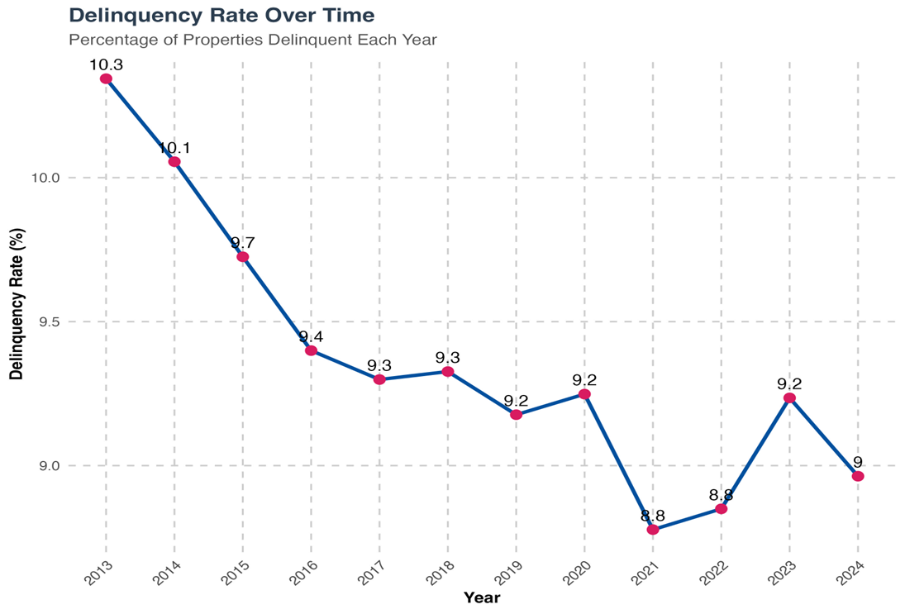
Delinquency Over Time
Delinquency rates show a gradual decline since 2013, with minor recent fluctuations.

Slide 10
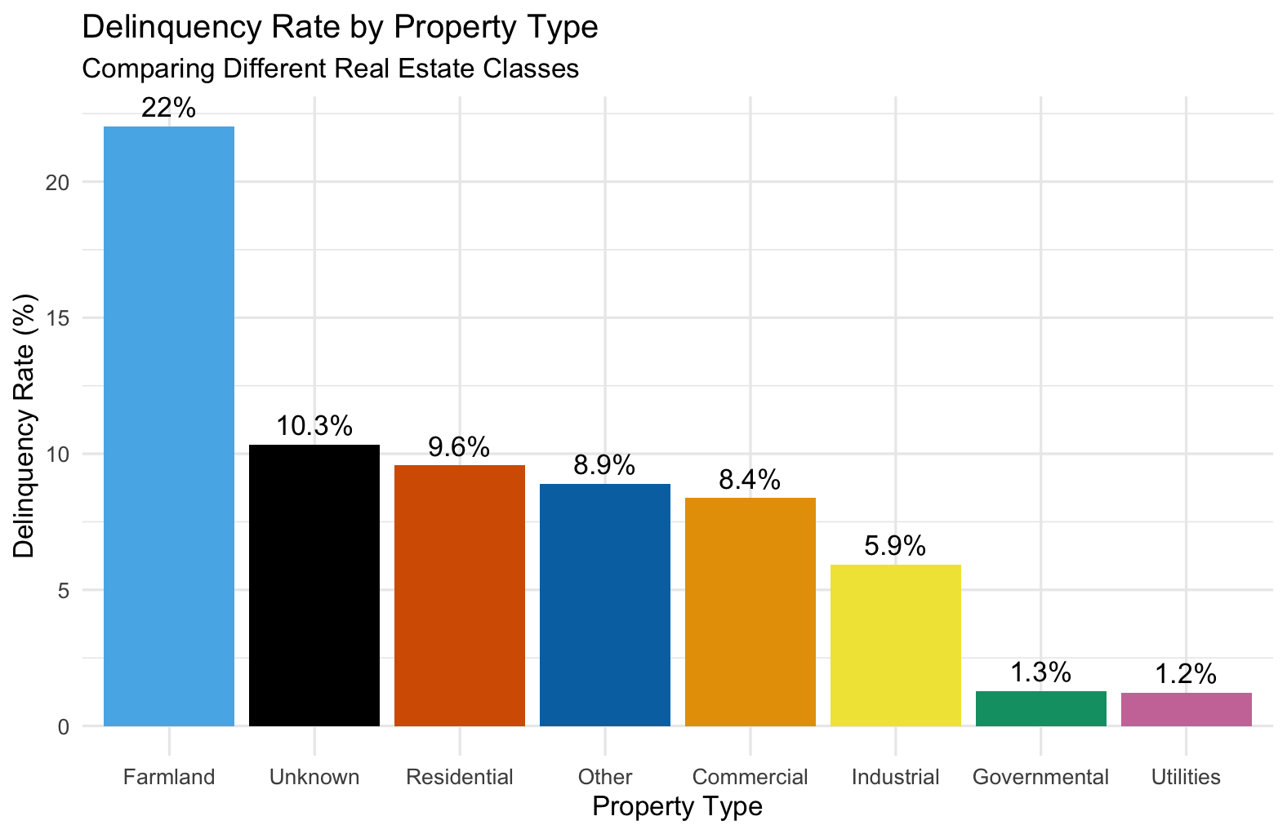
Delinquency & Property Types
Farmland properties have the highest delinquency rate, while government and utility properties show the lowest.

Slide 11
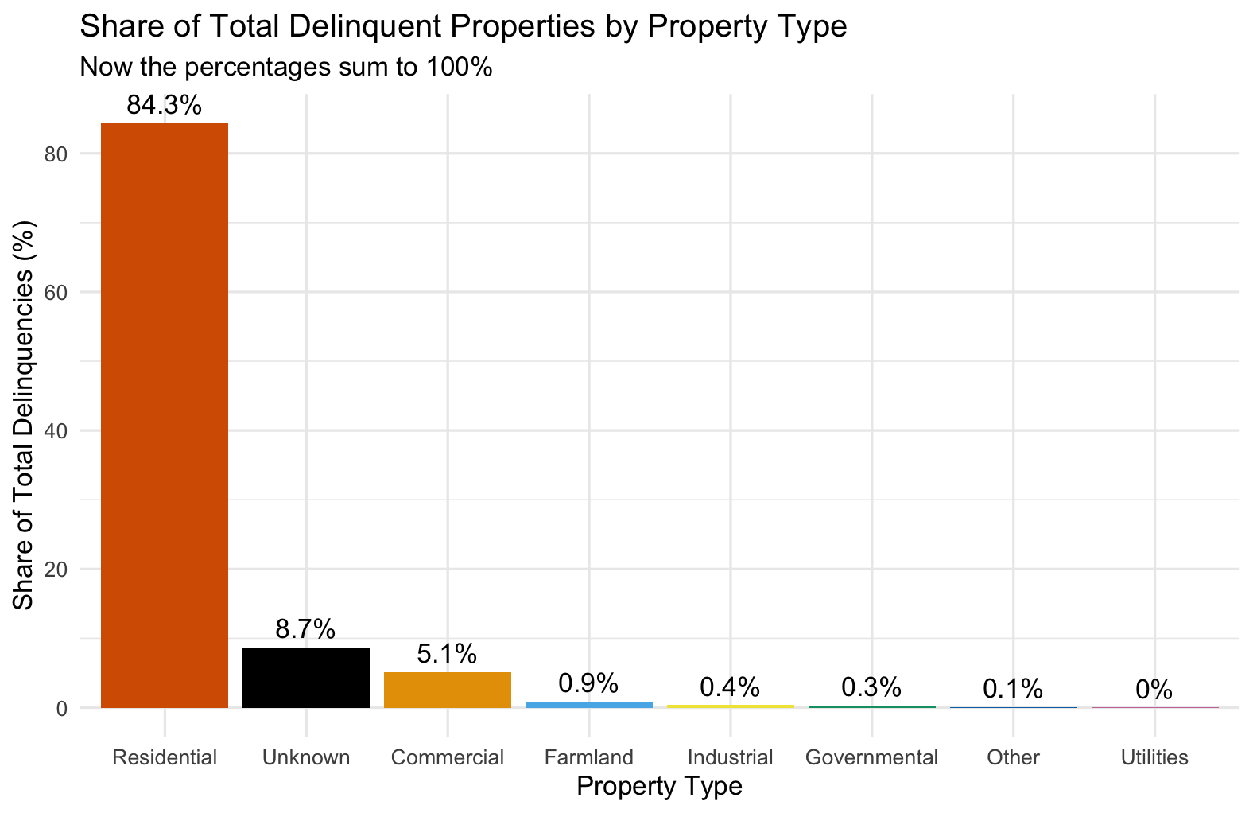
From Another Lense
Although Farmland has the highest delinquency rate, Residential properties account for over 84% of all delinquencies due to their large volume

Slide 12
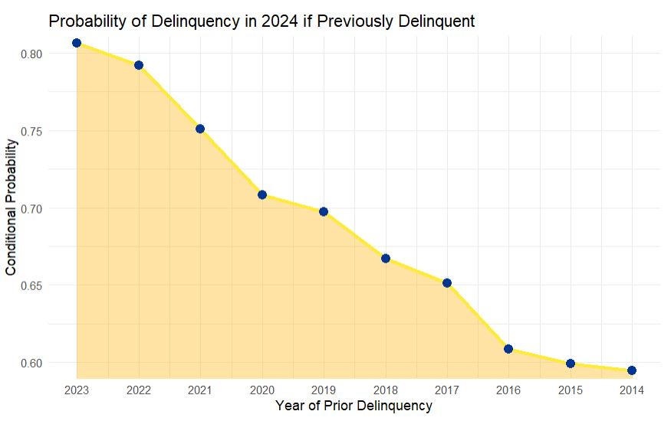
Lag Analysis
Delinquency stays around 10% when observing the entire population
Delinquency rates are much higher in parcels that have had previous delinquency
Delinquency rates of parcels who were delinquent just one year ago are around 80%
If delinquent 10 years ago, a parcels probability of being delinquent is still over 50%
But how many parcels are still delinquent from 10 years ago?

Slide 13
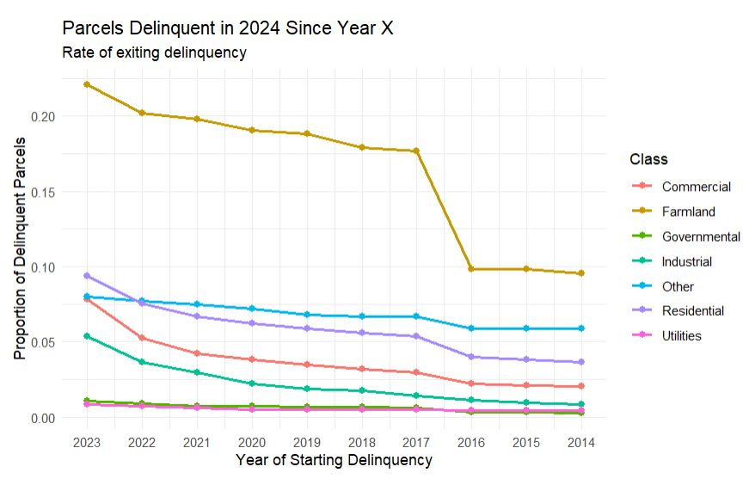
Chronic Delinquency
Demonstrates the proportion of parcels delinquent in 2024 that have been delinquent since a previous year.
As distance from 2024 increases, proportion of parcels delinquent decreases.
This is the rate at which parcels exit delinquency
The rate at which parcels exit delinquency is similar across class.

Slide 14
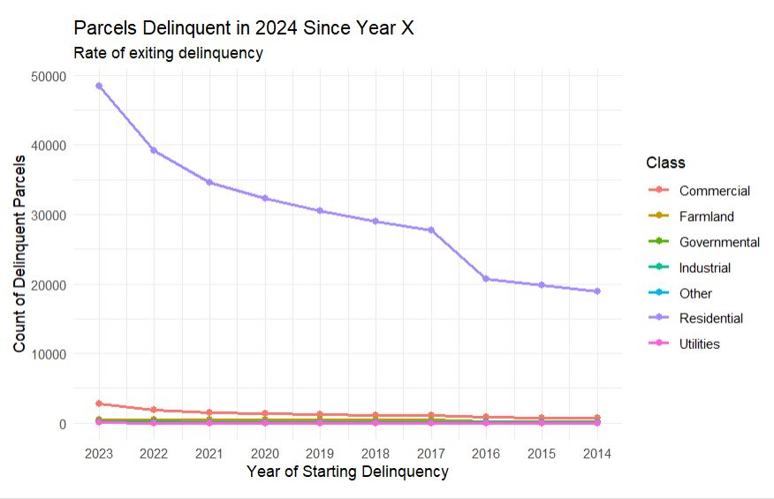
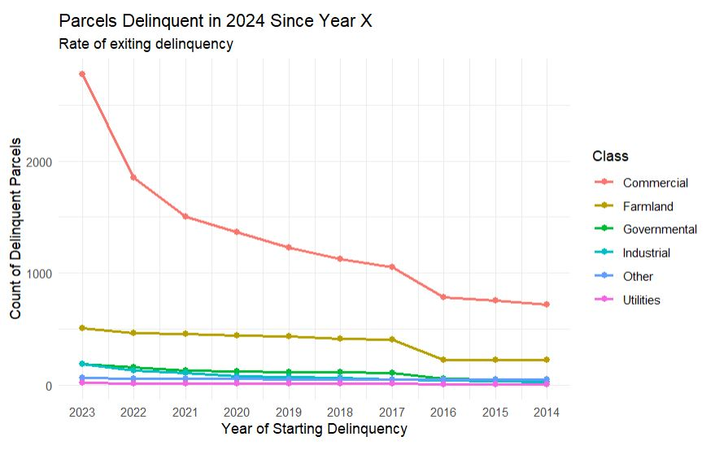
Raw counts comparisons

Slide 15
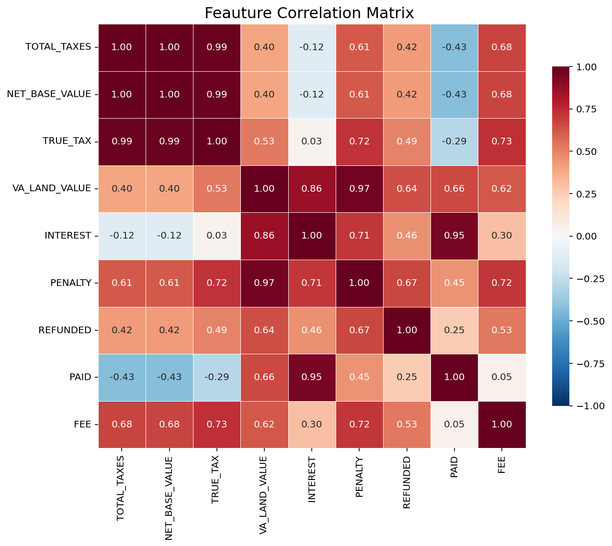
Correlation Issues
Before modeling, we examined how some key variables relate to each other.
Many variables are strongly correlated, meaning they scale similarly to one another.
Variables that are too similar reduce interpretability of our models.
Two features stood out as primary interests:
Net Base Value – the assessed value of the property
Total Taxes – the full tax burden on the property

Slide 16
OLS Regression Analyses
What is OLS?
It is a statistical method used to understand the relationship between one outcome and one or more factors that might influence it.
Why OLS?
We chose to use OLS regressions to understand how property value and tax levels are related to the likelihood of delinquency.
It helps us to identify whether changes in these financial factors are associated with higher or lower chances of a parcel being delinquent.

Slide 17
Initial OLS Results
The top regression looks at the relationship between net base value and delinquency alone.
A $10,000 increase in value slightly reduces the likelihood of delinquency by about 0.01 percentage points.
The bottom regression looks at the relationship between total tax owed and delinquency alone.
A $100 increase in property taxes reduces the likelihood of delinquency by about 0.02 percentage points.
Both regressions suggest a significant but minor negative relationship
But is this truly the case?

Slide 18
Combined Regression
Here we combined both variables into one regression.
A $10,000 increase in property value is associated with a 1.9% decrease in delinquency probability, controlling for total taxes.
Proxy for income?
A $100 increase in total taxes is associated with a 4.0% increase in delinquency probability, controlling for property value.
Fixed effects control for differences across municipalities and school zones such as crime, policies, or economic conditions
In other words, we’re comparing properties within each location to better isolate the effects of property value and total tax

Slide 19
Part IV: The Model
Prediction Model

Slide 20
Our Prediction Model
XG Boost
It is a powerful machine learning algorithm that uses past property tax data to estimate which properties are most likely to become delinquent in the future.
It observes a number of patterns within the data
how much tax is owed; what kind of property it is; where it's located; etc.
It then builds many small “decision trees” that each try to answer the question: “Will this property go delinquent?”
It then combines all the trees into one strong model

Slide 21
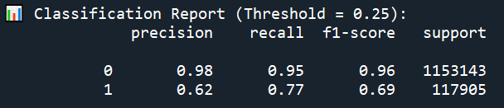
Model Performance
When the model predicts non delinquent, it’s right 98% of the time.
It catches 95% of properties that truly are not delinquent.
This means the model is very reliable at identifying low-risk properties.
When the model predicts a property as delinquent, it's right 62% of the time (some false alarms)
It catches 77% of all properties that were truly delinquent.
This means the model is aggressive about catching delinquency, even if it sometimes flags safe ones too.

Slide 22
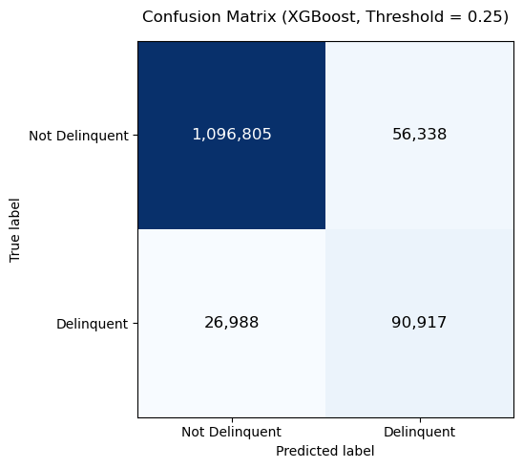
Raw Numbers
We tested the model on 1.27 million properties (20% of the data).
Properties are predicted “delinquent” if their risk is over 25%. This threshold helps catch more delinquents at the cost of more false positives
1,096,805 true negatives: Correctly identified as not delinquent
90,917 true positives: Correctly flagged as delinquent
56,338 false positives: Flagged as delinquent but weren’t
26,988 false negatives: Missed cases that became delinquent

Slide 23

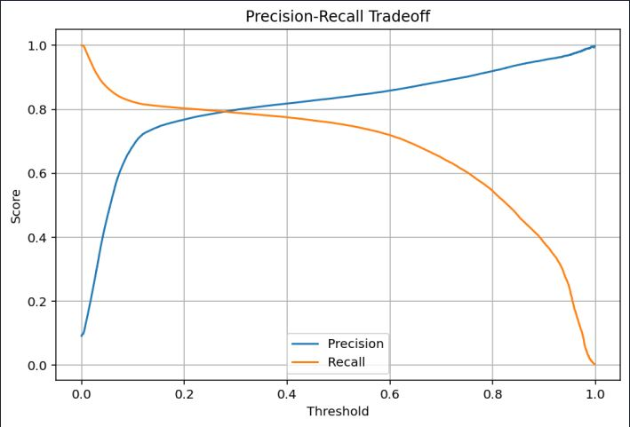

Threshold Adjustment
Recall – of the parcels truly delinquent, how many did we correctly identify
Precision – of all the parcels we said were delinquent, how many actually were.

Slide 24
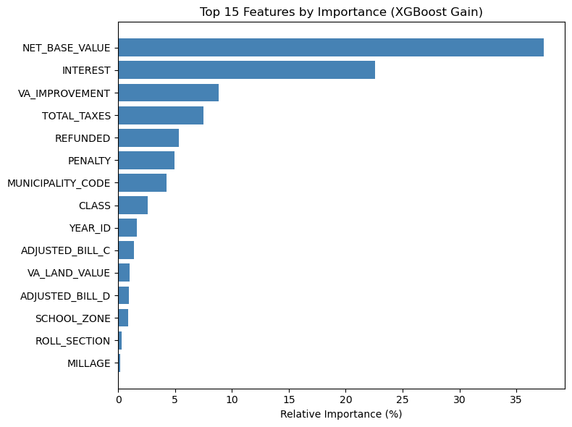
Strongest Predictors
Each bar shows how much that feature helped the model make accurate predictions.
How much a feature improves model accuracy (i.e., reduces error) on average when it’s used to split a node.
Net base value and Total Tax are both strong predictors.

Slide 25
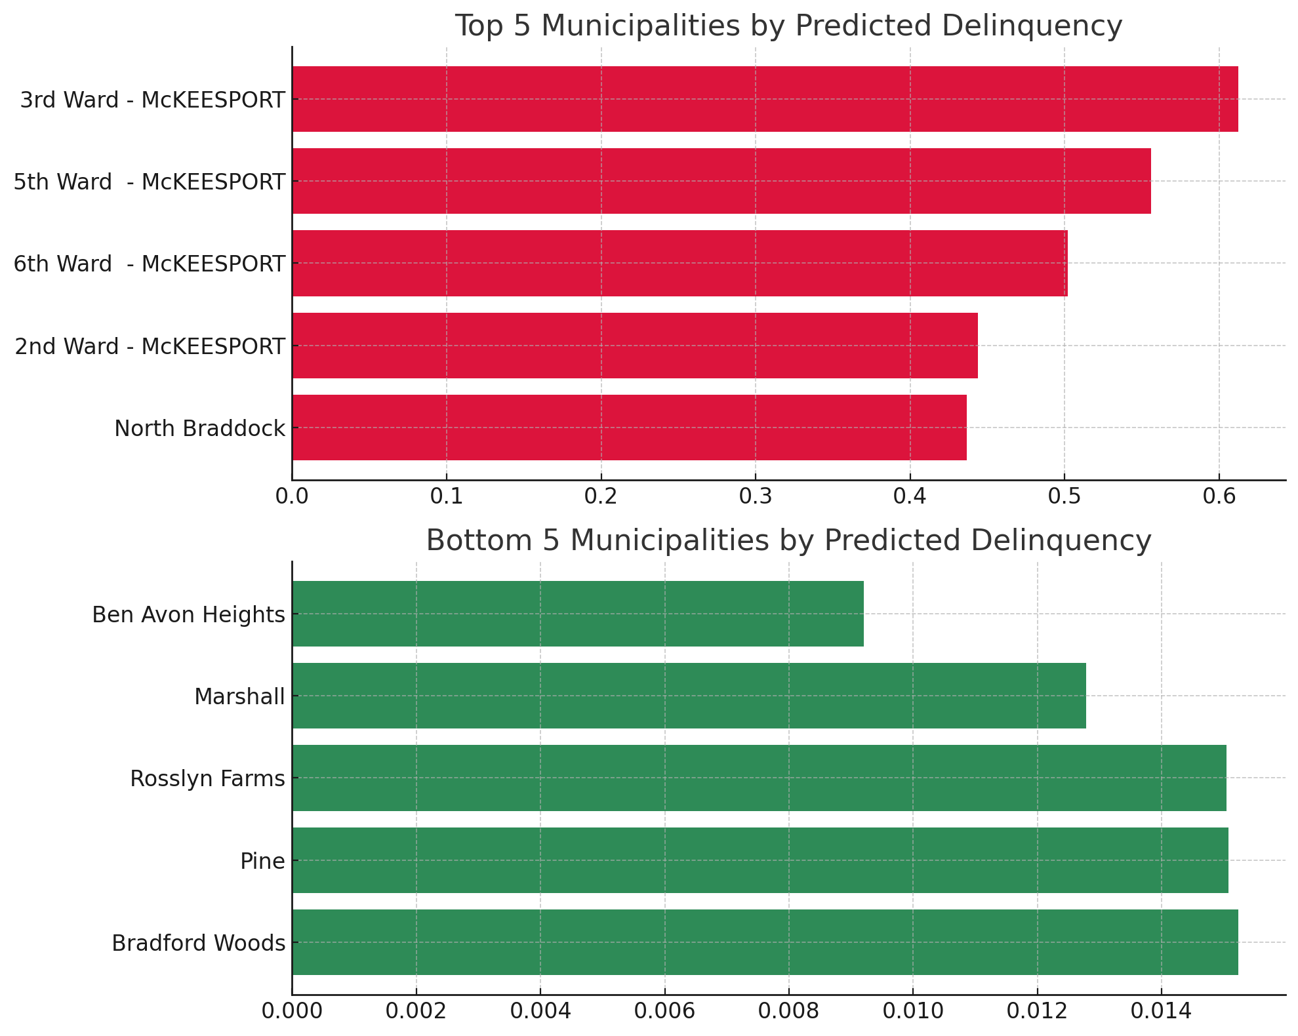
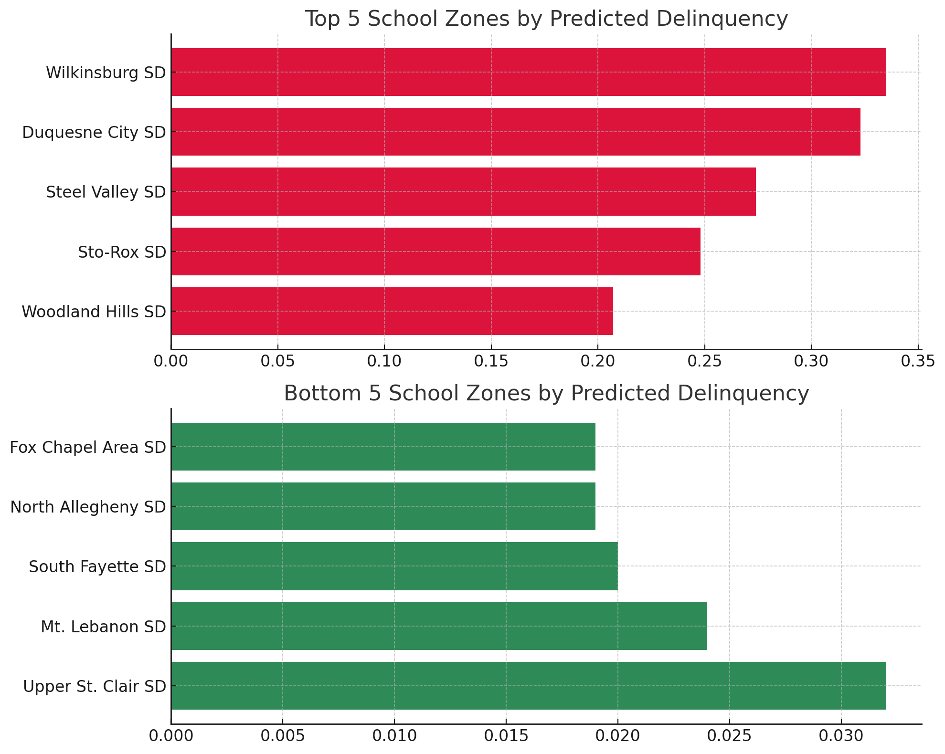
Locational Delinquency

Slide 26
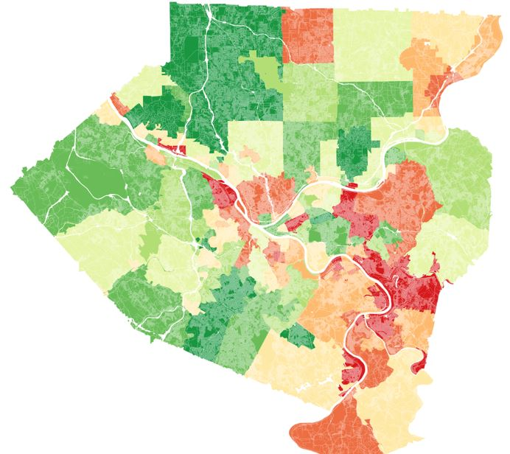
Delinquency By Municipality 2023
Historically delinquent municipalities are consistent with the predictions of our ML model.

Slide 27
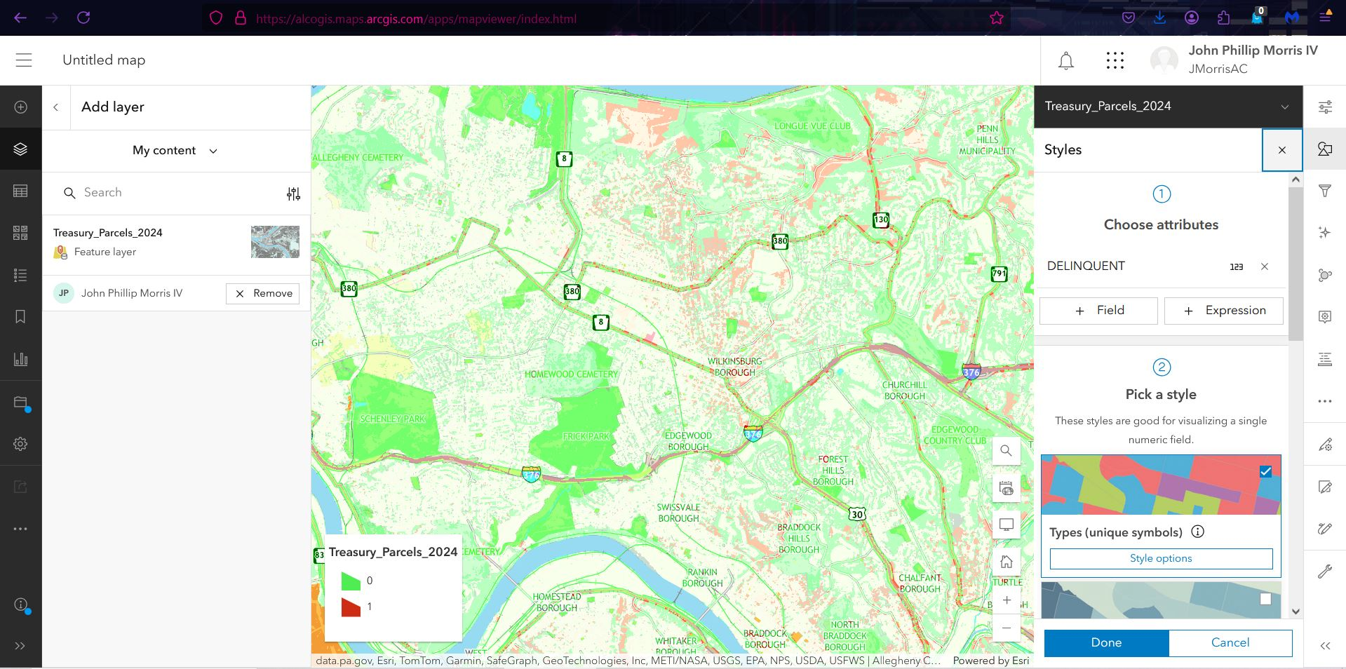
Treasury Data Arcgis Online
2024 Treasury data
Net Base value
School and municipality Millage
“Lag1” included to enable delinquency data from 2023 as well as 2024

Slide 28
Part V: Conclusions
Review

Slide 29
Objective Review
Who is perpetually delinquent?
Using the XG Boost model, we identified high-risk parcels based on financial history and location by flagging roughly 77% of delinquent cases
Key Indicators
Past Delinquency (LAG1)
Low net base value
High total taxes
Municipality/School Zone

Slide 30
Objective Review
Why are these parcels delinquent?
The OLS regressions show that higher property taxes and lower property values significantly increase the likelihood of delinquency
Additionally, we were able to also confirm that past records of delinquency also strongly predict whether or not a parcel will be delinquent
Can this be repeated for prediction?
Yes! The XG Boost model is structured to handle new data (e.g., for 2025) and is already trained to assign risk scores, making it ready for annual use with updated inputs.

Slide 31
Part VI: Next Steps
RCT Proposal
Policy Recommendations

Slide 32
RCT Design to Improve Tax Compliance
Goal:
Identify which type of mailed message best encourages delinquent property owners to pay.
Target Group:
Properties that were tax delinquent in the prior year.
Experimental Design:
Randomly assign parcels into four groups:
Control Group: No letter sent
Treatment 1: Simple reminder letter
Treatment 2: Reminder + Social Norms
(“Most property owners in your area pay on time”)
Treatment 3: Reminder + Economic Sanctions
(Warning of tax lien or sheriff sale)

Slide 33
RCT Design to Improve Tax Compliance
Measurement:
Whether payment is received by the tax deadline.
Why RCT?
It isolates causal effects of each message type, avoiding bias in observational data.
Literature Insight:
Prior studies across countries show these types of reminders can meaningfully improve payment rates.
A large field experiment in a major U.S. city found that reminders with economic threats (like liens) were the most effective in raising revenue.
Social norm messages were less powerful but still better than a basic reminder.

Slide 34
Allegheny County Treasury
Thank You!
Tyler Kellar, Behnam Fallah, John Morris, Jacob Hunsinger
April 16th, 2025

